Slide 1
Chapter 3 - Object Oriented Programming

Slide 2

Object Oriented Programming Concept
Class
Object
Method or function
Inheritance
Polymorphism
Encapsulation

Slide 3
Class
The class is one of the Basic concepts of OOPs which is a group of similar entities. It is only a logical component and not the physical entity. Lets understand this one of the OOPs Concepts with example, if you had a class called “Expensive Cars” it could have objects like Mercedes, BMW, Toyota, etc. Its properties(data) can be price or speed of these cars. While the methods may be performed with these cars are driving, reverse, braking etc.
Object
An object can be defined as an instance of a class, and there can be multiple instances of a class in a program. An Object is one of the OOPs concepts which contains both the data and the function, which operates on the data. For example - chair, bike, marker, pen, table, car, etc.
class version1: =>class(version1)
def build(x):
print("hello")
a=version1()
a.build() =>object(a)
print(isinstance(ob, hai))

Slide 4
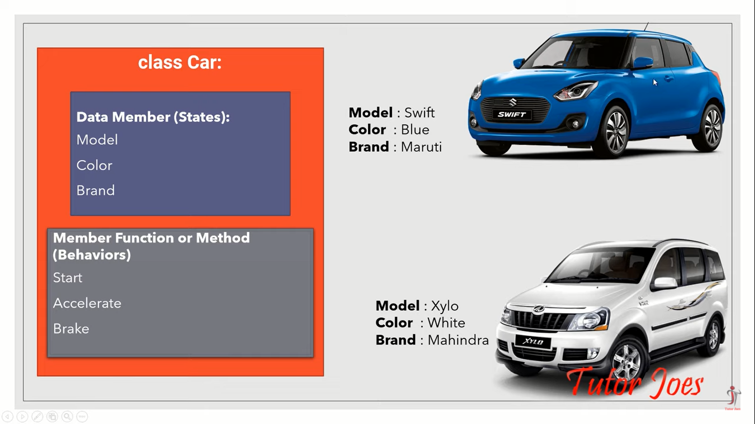
CAR=CLASS
MODEL,COLOR,FUEL=OBJECT
DRIVE=METHOD OR FUNCTION

Slide 5
User input
def build(a,b):
print(a)
print(b)
print(a+b)
x=int(input("Enter first no"))
y=int(input("Enter second number"))
build(x,y)

Slide 6
Pass by value(Class)
class version1:
def build(self,a,b):
print(a)
print(b)
print(a+b)
a=version1()
a.build(20,10)
Notes:
You defined a class named version1.
Inside it, you created a method build(self, a, b) that prints:
The first number a
The second number b
Their sum a + b
Note: The first parameter self is a reference to the current instance of the class — it’s automatically passed when you call the method on an object.
Here, you create an instance (object) of the class version1.
This calls the method build on the object a.
It passes the values 20 and 10 to the parameters a and b in the method.

Slide 7
Function or Methods
A method is a block of code that performs a specific task.
Call By Value
Call By Reference
Cal by Value
def build(a,b):
print(a)
print(b)
print(a+b)
build(10,20)

Slide 8
Call By Reference
def build(a,b):
print(a)
print(b)
print(a+b)
x=200
y=300
build(x,y) #x=a,y=b

Slide 9
Inheritance
One class inherits the attributes and methods of another class.
An inherited class can override, modify or augment the functions and attributes of its parent class.
An inherited class is known as Subclass or Derived Class.
Subclass inherits the properties or characteristics from Base Class, also popularly known as Super class.
Object Oriented Programming

Slide 10
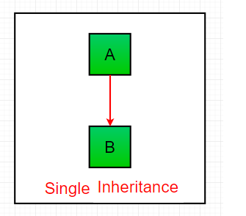
Single Inheritance: Single inheritance enables a derived class to inherit properties from a single parent class, thus enabling code reusability and the addition of new features to existing code.

Slide 11
class version1:
def build1(self):
a=10
b=-20
print(a+b)
def build2(self):
a=200
b=100
print(a-b)
class version2(version1):
def build3(self):
a=40
b=85
print(a*b)
def build4(self):
a=800
b=700
print(a/b)
a=version2()
a.build1()
a.build2()
a.build3()
a.build4()
Inheritance
Notes:
class version2(version1)
This means version2 inherits from version1.
So, version2 gets access to all the methods in version1.
It also defines its own methods:
build3() → multiplies 40 * 85
build4() → divides 800 / 700
a = version2()
Creates an object of the subclass version2.
Because of inheritance, a can call all four methods:
build1(), build2(), build3(), and build4().

Slide 12
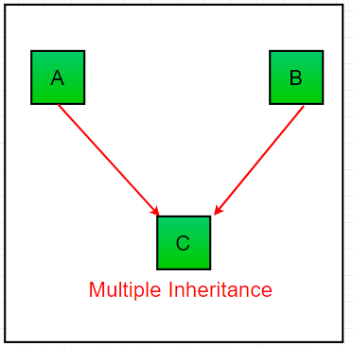
Multiple Inheritance: When a class can be derived from more than one base class this type of inheritance is called multiple inheritance. In multiple inheritance, all the features of the base classes are inherited into the derived class.

Slide 13
# Base class1
class Mother:
mothername = ""
def mother(self):
print(self.mothername)
# Base class2
class Father:
fathername = ""
def father(self):
print(self.fathername)
# Derived class
class Son(Mother, Father):
def parents(self):
print("Father :", self.fathername)
print("Mother :", self.mothername)
# Driver's code
s1 = Son()
s1.fathername = "RAM"
s1.mothername = "SITA"
s1.parents()

Slide 14
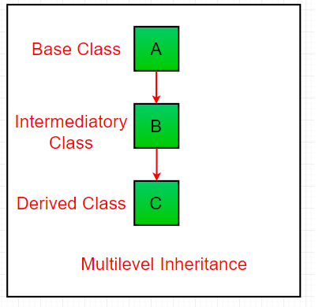
Multilevel Inheritance
In multilevel inheritance, features of the base class and the derived class are further inherited into the new derived class. This is similar to a relationship representing a child and grandfather.

Slide 15
class student:
def getStudent(self):
self.name = input("Name: ")
self.age = input("Age: ")
self.gender = input("Gender: ")
class test(student):
def getMarks(self):
self.stuClass = input("Class: ")
print("Enter the marks of the respective subjects")
self.literature = int(input("Literature: "))
self.math = int(input("Math: "))
self.biology = int(input("Biology: "))
self.physics = int(input("Physics: "))
class marks(test):
def display(self):
print("\n\nName: ",self.name)
print("Age: ",self.age)
print("Gender: ",self.gender)
print("Study in: ",self.stuClass)
print("Total Marks: ", self.literature + self.math + self.biology + self.physics)
m1 = marks()
m1.getStudent()
m1.getMarks()
m1.display()

Slide 16
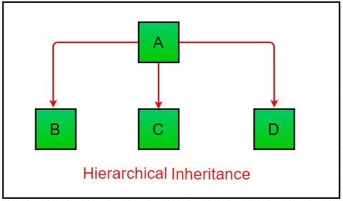
Hierarchical Inheritance: When more than one derived classes are created from a single base this type of inheritance is called hierarchical inheritance. In this program, we have a parent (base) class and two child (derived) classes.

Slide 17
# Base class
class Parent:
def func1(self):
print("This function is in parent class.")
# Derived class1
class Child1(Parent):
def func2(self):
print("This function is in child 1.")
# Derivied class2
class Child2(Parent):
def func3(self):
print("This function is in child 2.")
# Driver's code
object1 = Child1()
object2 = Child2()
object1.func1()
object1.func2()
object2.func1()
object2.func3()

Slide 18
Polymorphism
In Python, Polymorphism lets us define methods in the child class that have the same name as the methods in the parent class. In inheritance, the child class inherits the methods from the parent class. However, it is possible to modify a method in a child class that it has inherited from the parent class.
Method Overloading
Method Overriding

Slide 19
Polymorphism (Overriding)
When a subclass provides its own implementation of a method that already exists in the parent class, it is called overriding.
The method in the subclass replaces the parent’s method.
class version1:
def button(self):
print("color red")
class version2(version1):
def button(self):
print("color yellow")
a=version2()
a.button()

Slide 20
Overloading
When a class has multiple methods with the same name but different parameters, it is called overloading.
def product(a, b):
p = a * b
print(p)
def product(a, b, c):
p = a * b*c
print(p)
product(4, 5, 5)
Notes:
Python does NOT support traditional method overloading like Java or C++.
If you define multiple methods with the same name, the last one overwrites the previous ones.

Slide 21
class Cat:
def __init__(self, name, age):
self.name = name
self.age = age
def info(self):
print(f"I am a cat. My name is {self.name}. I am {self.age} years old.")
def make_sound(self):
print("Meow")
class Dog:
def __init__(self, name, age):
self.name = name
self.age = age
def info(self):
print(f"I am a dog. My name is {self.name}. I am {self.age} years old.")
def make_sound(self):
print("Bark")
cat1 = Cat("Kitty", 2.5)
dog1 = Dog("Fluffy", 4)
for animal in (cat1, dog1):
animal.make_sound()
animal.info()

Slide 22
__init__ :
"__init__" is a reseved method in python classes. It is known as a constructor in object oriented concepts. This method called when an object is created from the class and it allow the class to initialize the attributes of a class.

Slide 23
What is the use of Self in Python?
The self is used to represent the instance of the class. With this keyword, you can access the attributes and methods of the class in python. It binds the attributes with the given arguments. The reason why we use self is that Python does not use the ‘@’ syntax to refer to instance attributes. In Python, we have methods that make the instance to be passed automatically, but not received automatically.

Slide 24
Encapsulation
Encapsulation is one of the fundamental concepts in object-oriented programming (OOP).
It describes the idea of wrapping data and the methods that work on data within one unit. This puts restrictions on accessing variables and methods directly and can prevent the accidental modification of data.
To prevent accidental change, an object’s variable can only be changed by an object’s method. Those types of variables are known as private variable.

Slide 25
If the class member declared as public then it can be accessed everywhere.
If the class members declared as protected then it can be accessed only within the class itself and by inheriting and parent classes.
If the class members declared as private then it may only be accessed by the class that defines the member.

Slide 26
Encapsulation
class employee(object):
def __init__(self):
self.name = “syscom”
self._age = 25
self.__salary = 1234
object1 = employee()
print(object1.name)
print(object1._age)

Slide 27




Your title here
class employee(object):
def __init__(self):
self.name = “syscom”
self._age = 25
Presentations are communication tools that can be used as demonstrations.
Presentations are communication tools that can be used as demonstrations.
Presentations are communication tools that can be used as demonstrations.
Presentations are communication tools that can be used as demonstrations.

Slide 28
Public
class Geek:
# constructor
def __init__(self, name, age):
# public data members
self.geekName = name
self.geekAge = age
# public member function
def displayAge(self):
# accessing public data member
print("Age: ", self.geekAge)
# creating object of the class
obj = Geek("R2J", 20)
# accessing public data member
print("Name: ", obj.geekName)
# calling public member function of the class
obj.displayAge()
Public Access Modifier:
The members of a class that are declared public are easily accessible from any part of the program. All data members and member functions of a class are public by default.
In the above program, geekName and geekAge are public data members and displayAge() method is a public member function of the class Geek. These data members of the class Geek can be accessed from anywhere in the program.

Slide 29
class Student:
# protected data members
_name = None
_roll = None
_branch = None
# constructor
def __init__(self, name, roll, branch):
self._name = name
self._roll = roll
self._branch = branch
# protected member function
def _displayRollAndBranch(self):
# accessing protected data members
print("Roll: ", self._roll)
print("Branch: ", self._branch)
# derived class
class Geek(Student):
# constructor
def __init__(self, name, roll, branch):
Student.__init__(self, name, roll, branch)
# public member function
def displayDetails(self):
# accessing protected data members of super class
print("Name: ", self._name)
# accessing protected member functions of super class
self._displayRollAndBranch()
# creating objects of the derived class
obj = Geek("R2J", 1706256, "Information Technology")
# calling public member functions of the class
obj.displayDetails()

Slide 30
Protected Access Modifier:
The members of a class that are declared protected are only accessible to a class derived from it. Data members of a class are declared protected by adding a single underscore ‘_’ symbol before the data member of that class.

Slide 31
In the above program, _name, _roll and _branch are protected data members and _displayRollAndBranch() method is a protected method of the super class Student. The displayDetails() method is a public member function of the class Geek which is derived from the Student class, the displayDetails() method in Geek class accesses the protected data members of the Student class.

Slide 32
Private Access Modifier:
The members of a class that are declared private are accessible within the class only, private access modifier is the most secure access modifier. Data members of a class are declared private by adding a double underscore ‘__’ symbol before the data member of that class.
class Geek:
# private members
__name = None
__roll = None
__branch = None
# constructor
def __init__(self, name, roll, branch):
self.__name = name
self.__roll = roll
self.__branch = branch
# private member function
def __displayDetails(self):
# accessing private data members
print("Name: ", self.__name)
print("Roll: ", self.__roll)
print("Branch: ", self.__branch)
# public member function
def accessPrivateFunction(self):
# accesing private member function
self.__displayDetails()
# creating object
obj = Geek("R2J", 1706256, "Information Technology")
# calling public member function of the class
obj.accessPrivateFunction()

Slide 33
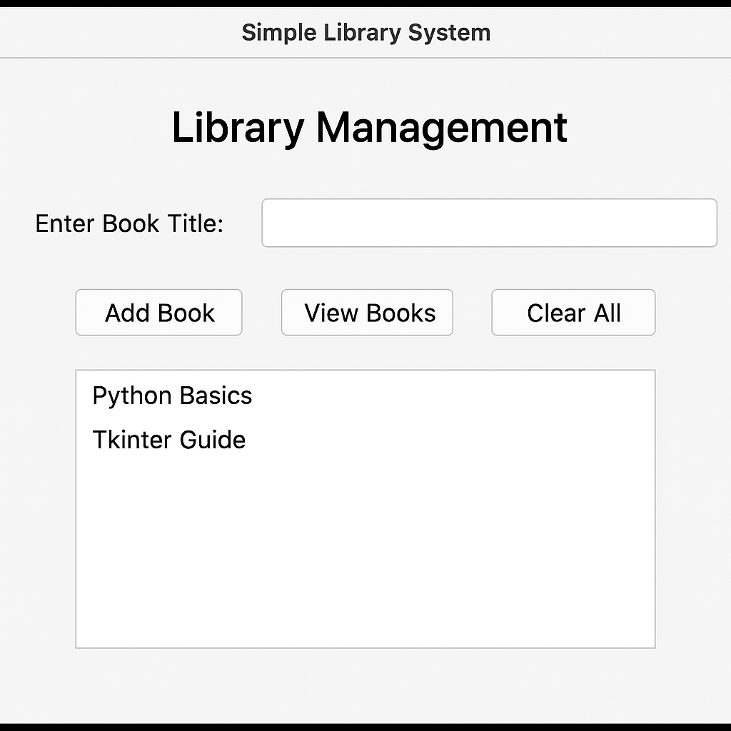
Write a program of Library Management System using class + Tkinter, with only the most basic features:
✅ Add a book
✅ View all books
✅ Clear the list

Slide 34
from tkinter import *
# -------- Library Class -------- #
class Library:
def __init__(self):
self.books = [] # list to store book names
def add_book(self, title):
if title != "":
self.books.append(title)
return True
else:
return False
def view_books(self):
return self.books
def clear_books(self):
self.books.clear()
# -------- GUI Class -------- #
class LibraryApp:
def __init__(self, root):
self.library = Library()
self.root = root
self.root.title("Simple Library System")
self.root.geometry("400x300")
Label(root, text="Library Management", font=("Arial", 16, "bold")).pack(pady=10)
# --- Entry box for book title --- #
Label(root, text="Enter Book Title:").pack()
self.title_entry = Entry(root, width=40)
self.title_entry.pack(pady=5)
# --- Buttons --- #
Button(root, text="Add Book", command=self.add_book).pack(pady=5)
Button(root, text="View Books", command=self.view_books).pack(pady=5)
Button(root, text="Clear All", command=self.clear_books).pack(pady=5)
# --- Listbox to show books --- #
self.listbox = Listbox(root, width=50, height=10)
self.listbox.pack(pady=10)
# --- Button Functions --- #
def add_book(self):
title = self.title_entry.get()
added = self.library.add_book(title)
if added:
self.title_entry.delete(0, END)
self.view_books() # refresh list
else:
self.listbox.insert(END, "Please enter a book title!")
def view_books(self):
self.listbox.delete(0, END)
for book in self.library.view_books():
self.listbox.insert(END, book)
def clear_books(self):
self.library.clear_books()
self.listbox.delete(0, END)
# -------- Main Program -------- #
root = Tk()
app = LibraryApp(root)
root.mainloop()

